Slide 1
Data Analysis and Handling with Pandas
Notes:
Where we are now. How to become data scientiest. By working or by sitting.
By understanding or by listening. By inlvolving or by excusing. By taking interest or by feeling bore. What is the value things you have. If you have some values, you enjoy listening your mom and feel her that are so innocent kid, (even you are not)
Complaining, excusing, depressing, frustrating, confusing. Togahter we can take over such tings.
Supporting each others. Engaging our colleges, sitting next to us. Could be a partner in crime or partner in success. A great time pass could be most valuable time for you

Slide 2
Introduction
It contains data structures and data manipulation tools designed to make data cleaning and analysis fast and easy in Python.
Pandas is designed for working with tabular or heterogeneous data.
NumPy, by contrast, is best suited for working with homogeneous numerical array data.

Slide 3
Why Data Handling
We need to manage Multi -dimensional data for our AI projects
Organized and well managed data is a requirment for All Steps in AI (Training, Validation, Testing, and Predicting)

Slide 4
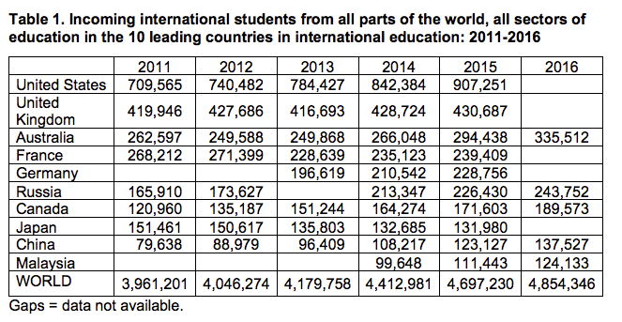
Example: International Students

Slide 5
Different Types of data….
Textual data (Reviews, comments, News, posts)
Numerical Data (Labour Force, litracy rate, economics indicators
Pictures
Videos
Time Series (Daily temperatures for 5 years)
Other Patterns

Slide 6
Common Action over data
Collecting and Storing,
Filtering Sampling,
Filling and removing Duplicates
Merging and Splitting

Slide 7
Data processing pipeline: a typical example
Collecting
Filling Missing
Removing Uncessary Data
Adding new data
Data Spliting
Feeding to ML
Large Data handling

Slide 8
For starters
Series.
Dataframe.
Data loading, storage and manipulation.

Slide 9
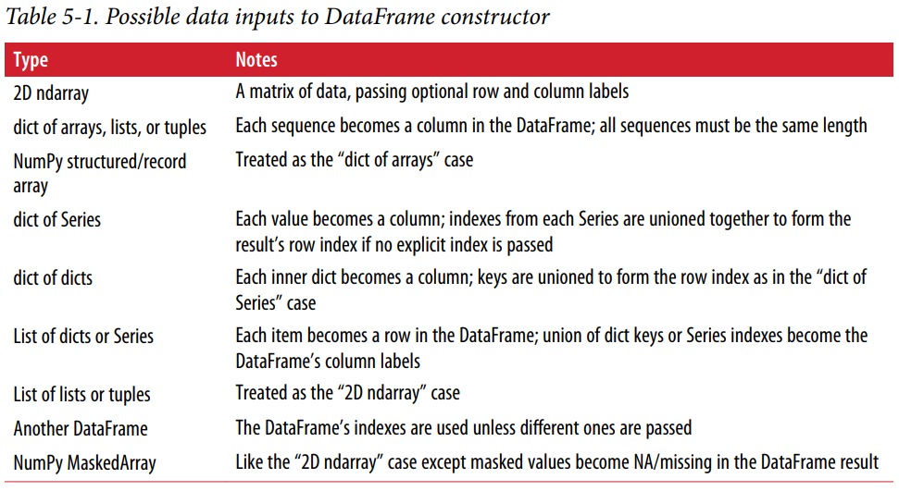

Slide 10
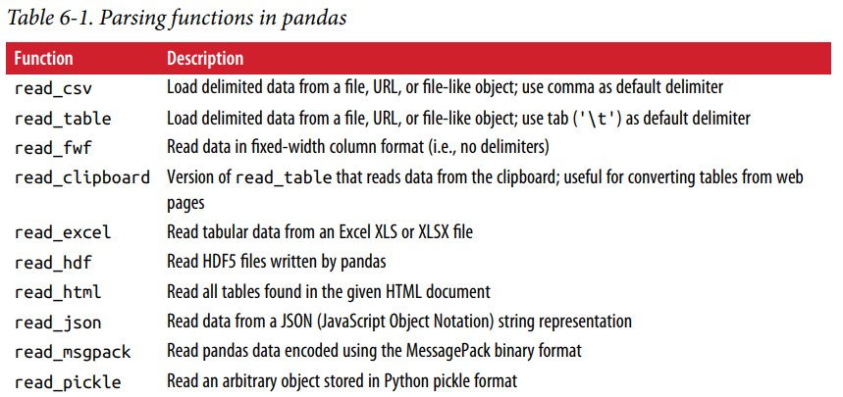
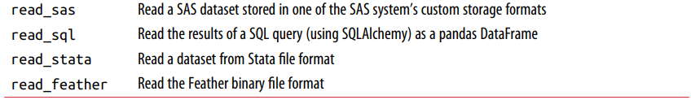
Reading data in pandas

